Slide 1
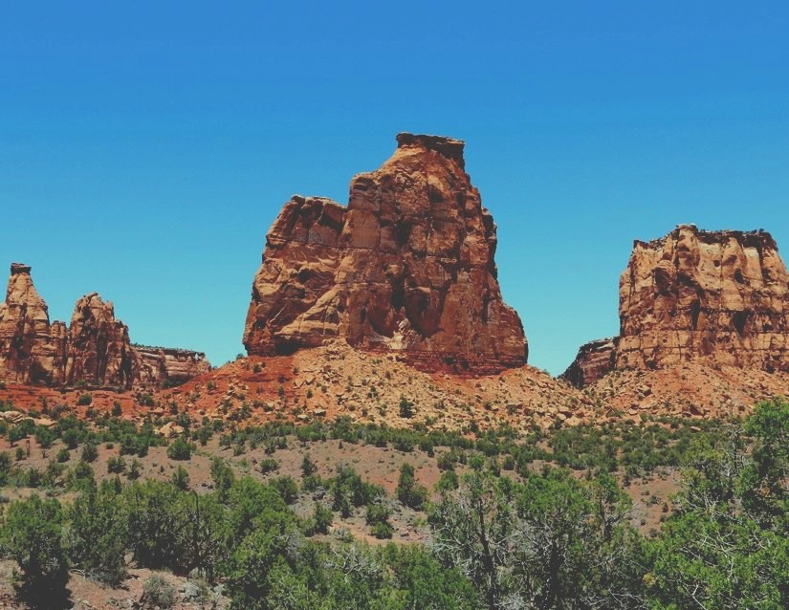
NVOS Management
Grand Junction, Colorado
Department of Energy
By Sierra Generette

Slide 2
Introduction
What are the Nevada Offsites?
Legacy Management (LM) is the Department of Energy’s steward of many closed environmental sites in the US
LM is responsible for performing long term surveillance and maintenance
The Nevada Offsites program manages nine sites where underground nuclear tests and weapons-related experiments were performed outside the boundaries of the Nevada National Security Sites in the 1960s & 1970s

Slide 3
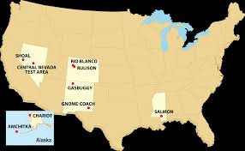
NVOS Cont.
On October, 1, 2006 LM assumed responsibility for these sites
All NVOS have completed surface remediation and environmental monitoring programs
Monitoring programs include the evaluation and reporting of environmental monitoring data

Slide 4


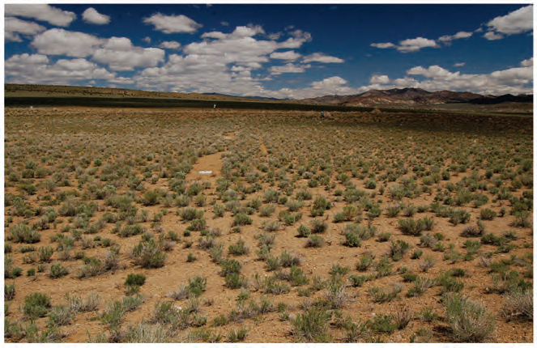
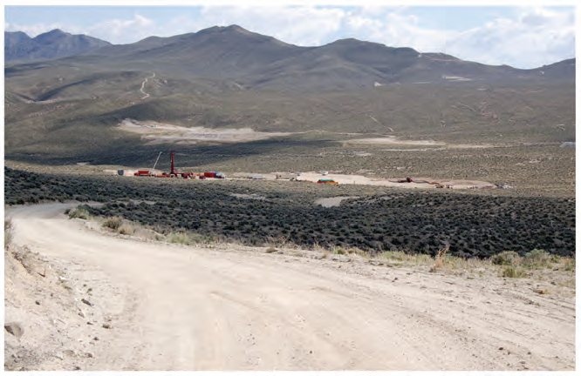
Central Nevada Test Site
Shoal

Slide 5
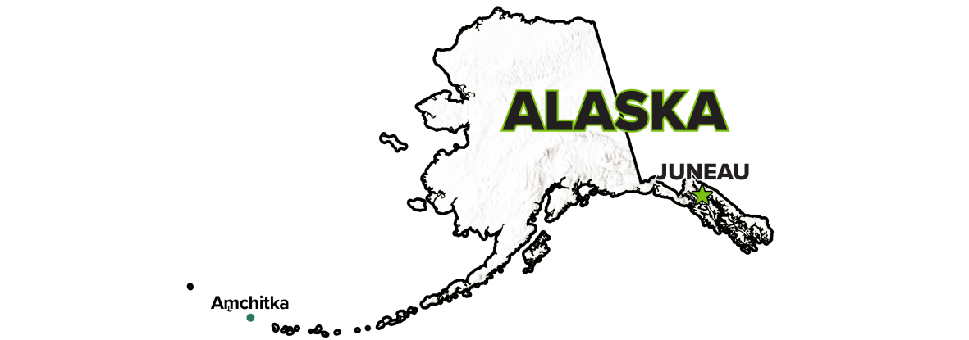

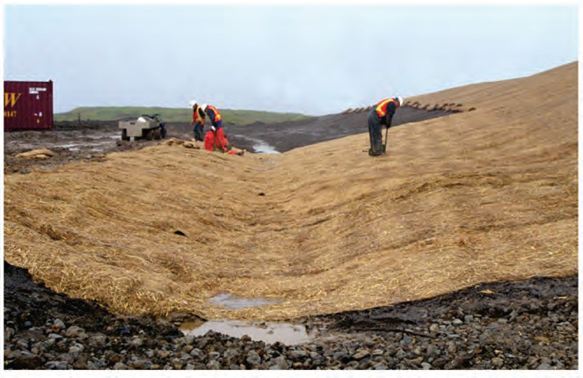
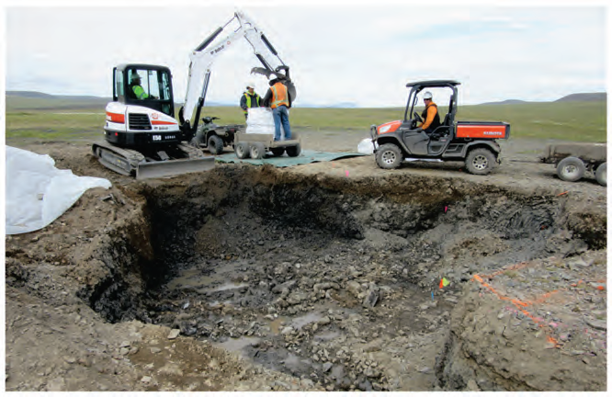
Amchitka
Chariot

Slide 6


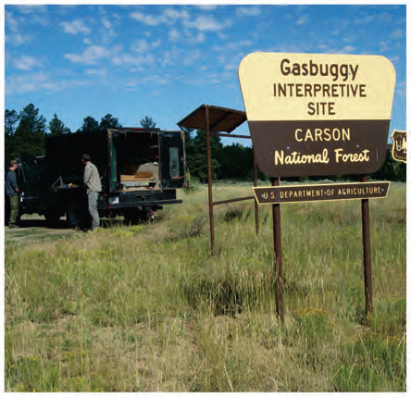
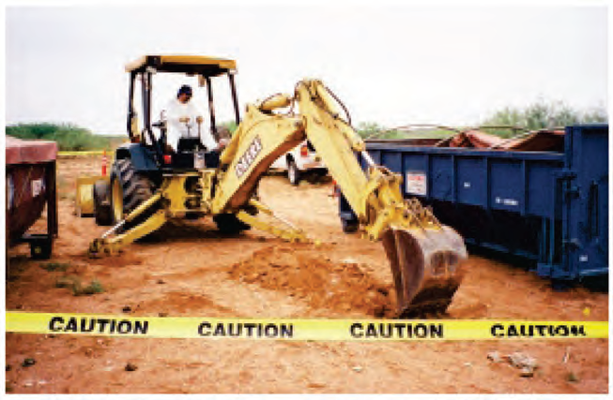
Gasbuggy
Gnome-Coach

Slide 7
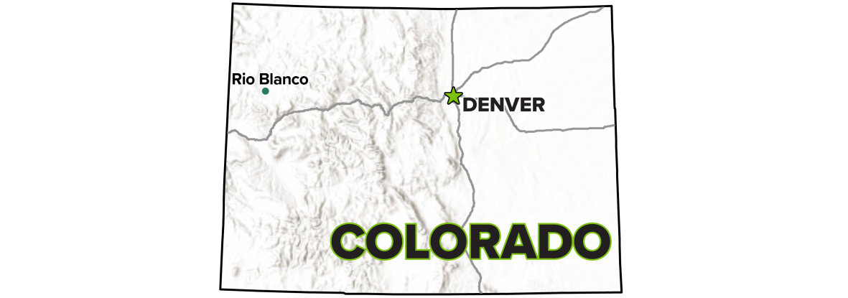
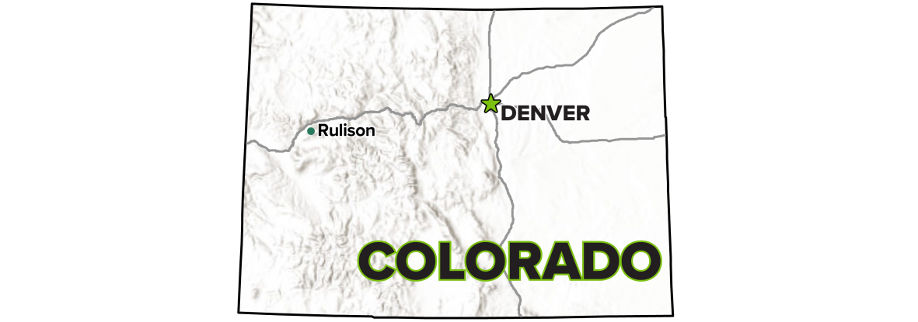
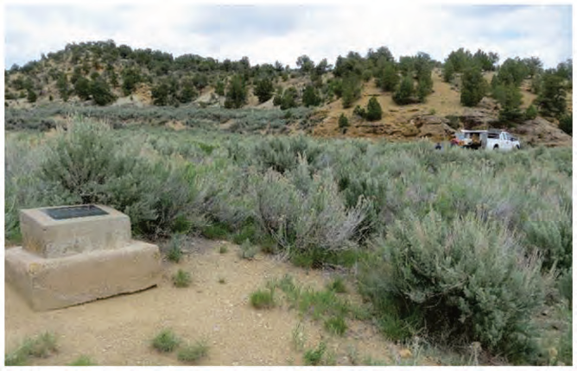
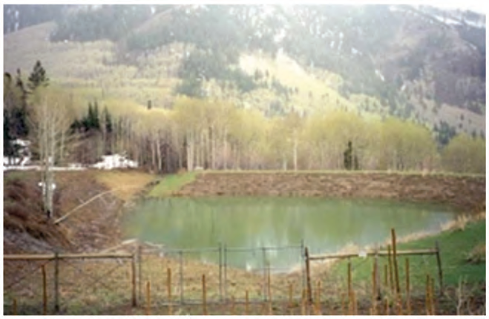
Rio Blanco
Rulison

Slide 8

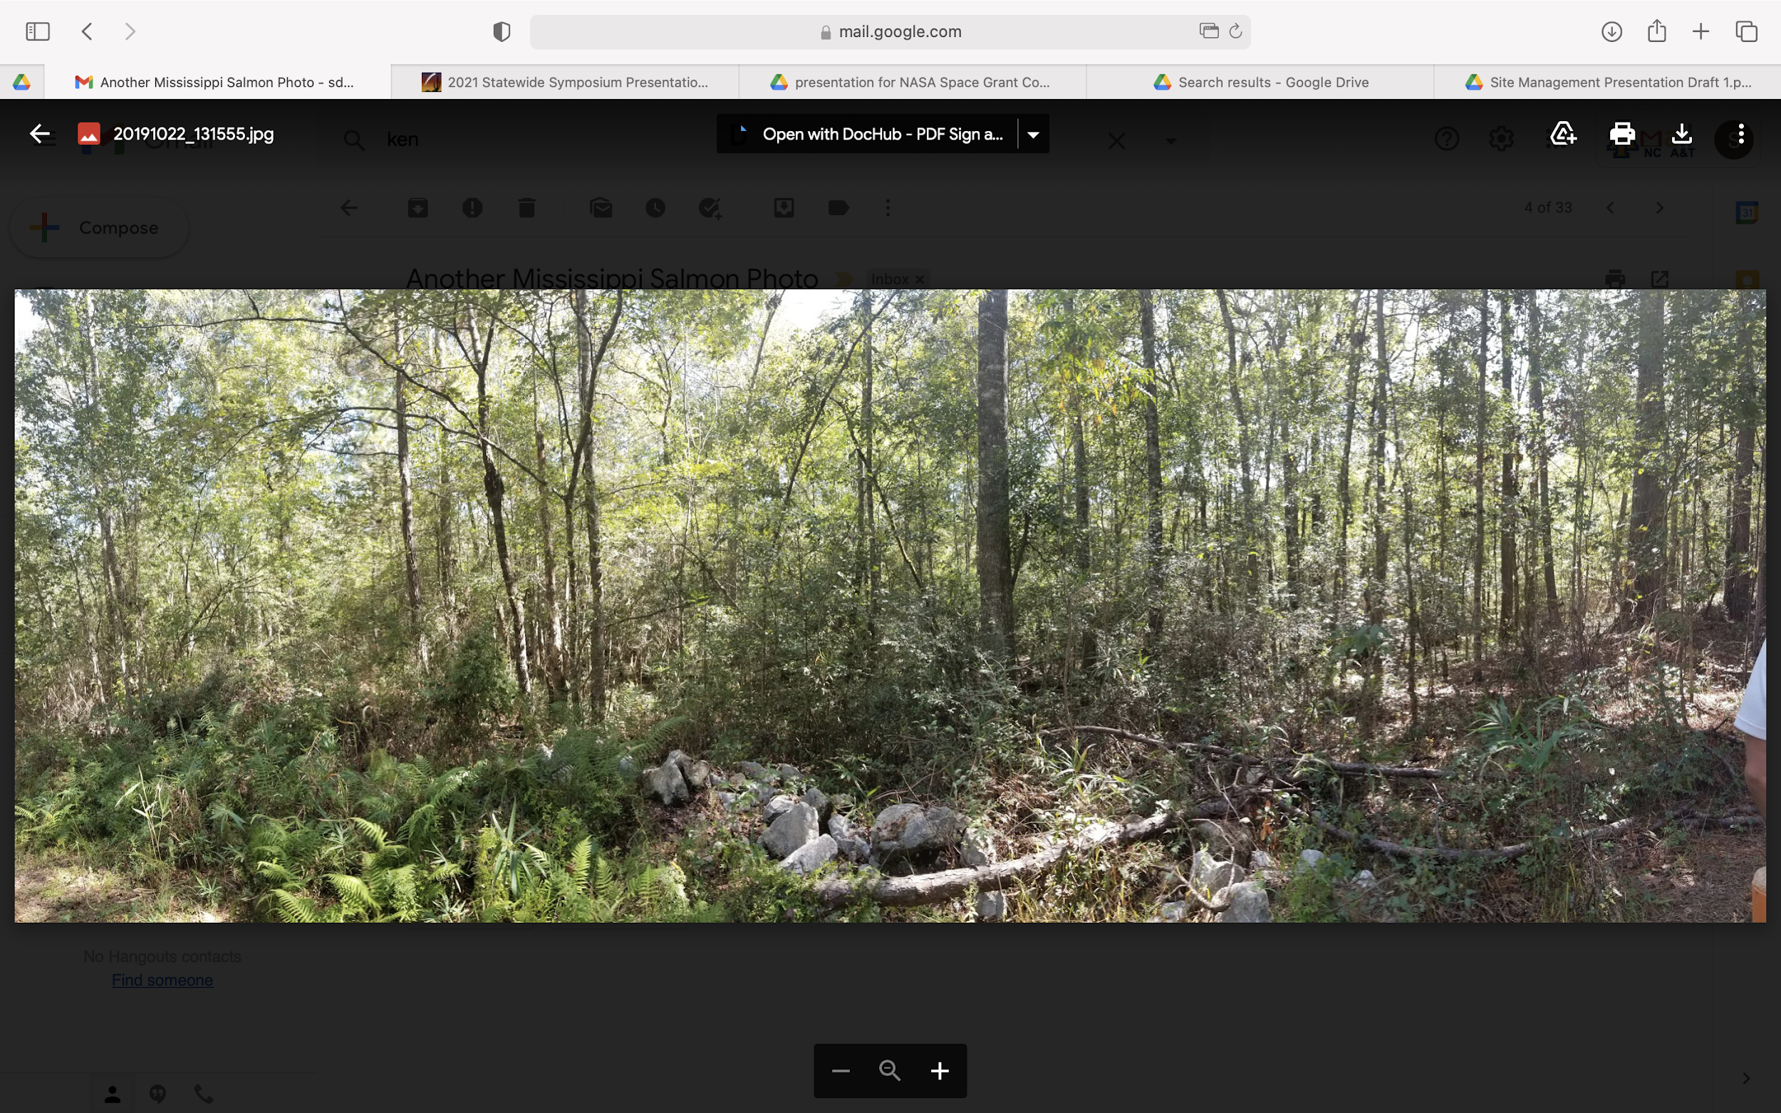

Slide 9
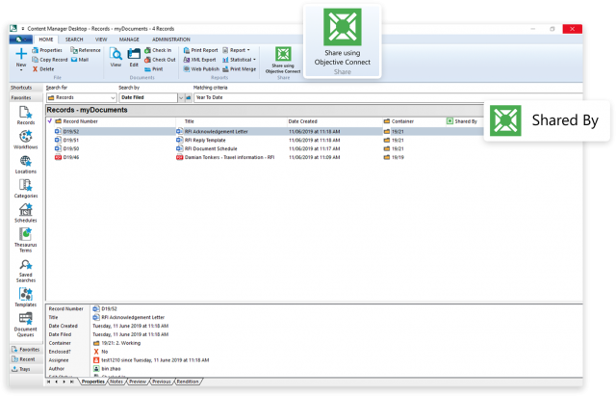
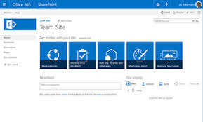
Content Manager (CM)
SharePoint (CM)
A web based collaborative platform that manages content
Site Logs were uploaded on SharePoint after all site logs were completed
Record system that assists LM in meeting regulatory and legal requirements for managing records
Ability to create, search, and manage information
Used to search information on the sites that would go into the log

Slide 10
Project Description
Problem
Within management requirements and practices some obligations do not align with LM practices
Changes in personnel and the lack of thorough knowledge in management practices
Solution
Site Management logs were created to include historical information that captures decisions, recommendations, and obligations made for each of the sites from 2006 to present
Ensures that LM is keeping track of management decisions for each of the sites for years to come

Slide 11
Project Draft
This basis of the project involved the Site Management logs that captured
  decisions
  recommendations
  obligations
A drafted template of the site logs was created and reviewed
Gnome Coach
Year | Summary | Record Name | Record Number
2020
2019
2018

Slide 12
Site Log (Example 1)
Rulison
Year | Summary | Record Name
2020 | Enclosed is the final Rulison Monitoring Plan, Revision 1, for the Rulison, Colorado, Site. The plan outlines LM’s strategy for monitoring natural gas wells within 1-mile of the Rulison, Colorado, Site. It has also been revised to address review comments received by the Colorado Oil and Gas Conservation Commission. | Rulison Monitoring Plan, Revision 1 (Letter)
2019 | The detection of tritium at concentrations of 8.6, 12.6, and 14.1 pCi/L in the samples collected from the Cary Weldon House, Morrisania Ranch, and Potter Ranch, respectively, is consistent with tritium concentrations in precipitation that resulted from above ground nuclear tests and is not attributed to the Rulison underground nuclear test. | 2019 Long-Term Hydrologic Monitoring Program Report for Rulison, Colorado, Site
2018 | It was recommended to continue annual monitoring activities (sampling and measuring water levels) and reporting as prescribed in the 2014 Data Acquisition Plan | 2018 Long-Term Hydrologic Monitoring Program Report for Rulison, Colorado, Site

Slide 13
Project Cont.
The monitoring reports consisted of either a summary, recommendation, or both. The year column represented the years that the monitoring report was conducted, which started from 2006
With the help of Content Manager and the public documents on the LM website each site log was filled with information:
  Deviation from normal/planned activities
  future changes in the way LM intends to do work
  letters documenting a decision
  recommendations
  agreements

Slide 14
Conclusion
It will be easier to maintain the sites in the future and make it easier for LM to manage the NVOS
This project will serve as a guide to make sure that LM keeps up with obligations and document changes
In order to keep the process in place, one would need to update each of the nine NVOS
This project was a great opportunity to get first hand experience about waste management

Slide 15


Acknowledgements
Mr. Clarence Brown
Dr. Melinda Downing
Mr. Ken Kreie
Ms. Jackie Petrello
Ms. Angelita Denny
Ms. Kathi Cole
Mr. Jason Nguyen

Slide 16
Resources
https://www.energy.gov/sites/prod/files/2020/05/f74/NVOFactSheet_0.pdf
https://www.energy.gov/lm/sites/lm-sites?Regulatory-Driver=Nevada%20Offsites
https://www.lm.doe.gov/2018LTS-Conference/contact.html
http://www.precollegeuniversity.com/mentorship-%20environmental-scholars.php#:~:text=The%20MES%20Program%20is%20a,in%20the%20environmental%20science%20disciplines.

Slide 17
Thank You!
Any Questions?

